Slide 1
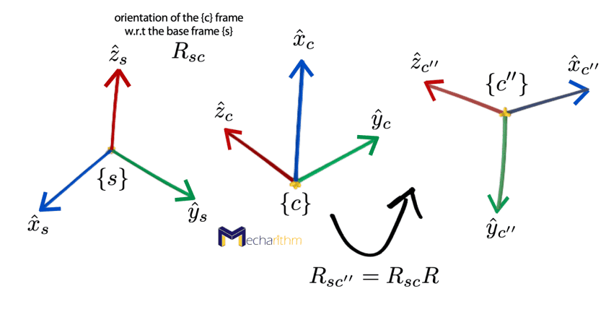
Kinematics and Dynamics
Day 02 | MP 3010

Slide 2
Coordinate frames, mapping and translation matrix
Section 1

Slide 3
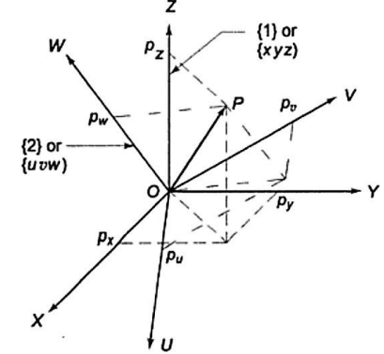


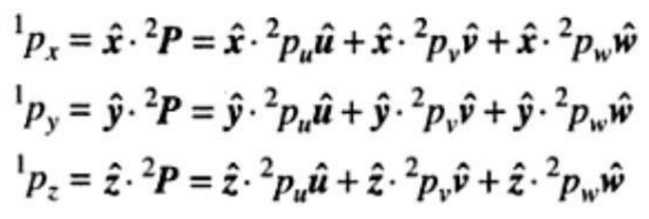
Coordinate frames

Slide 4
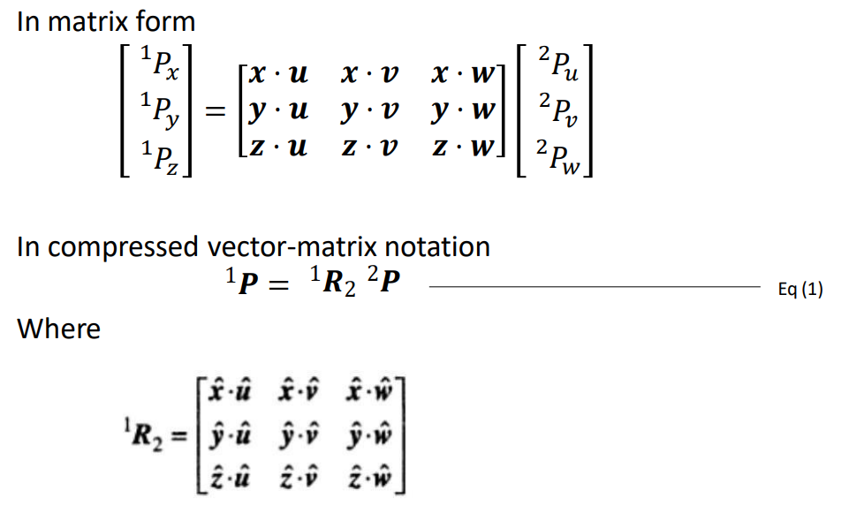
Matrix form

Slide 5
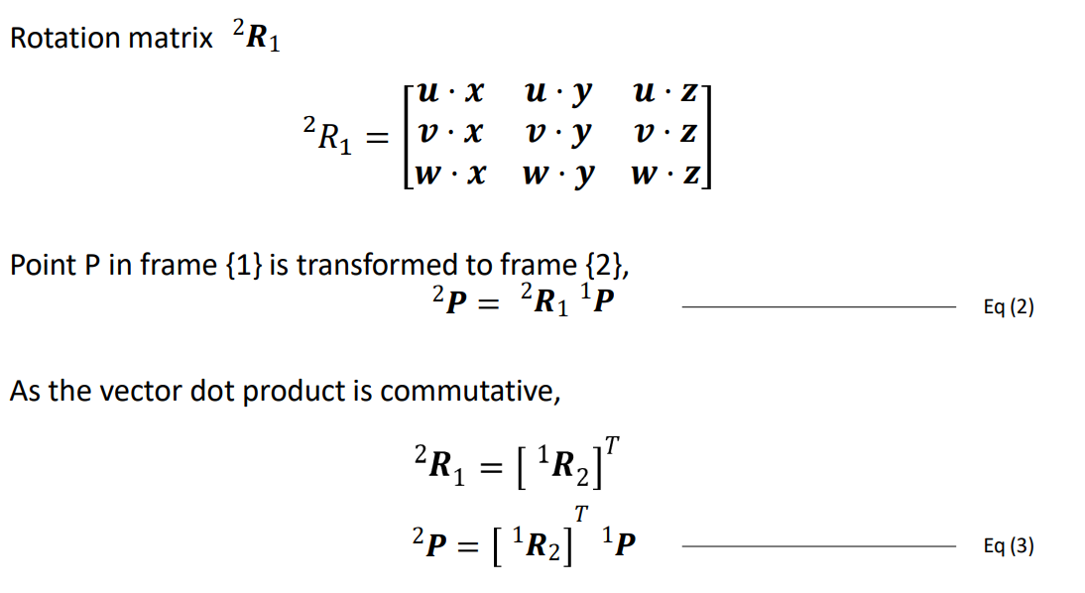

Slide 6
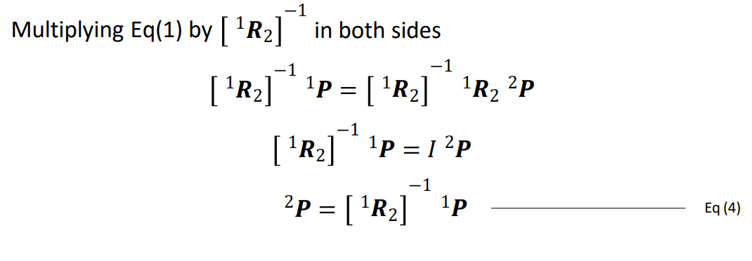
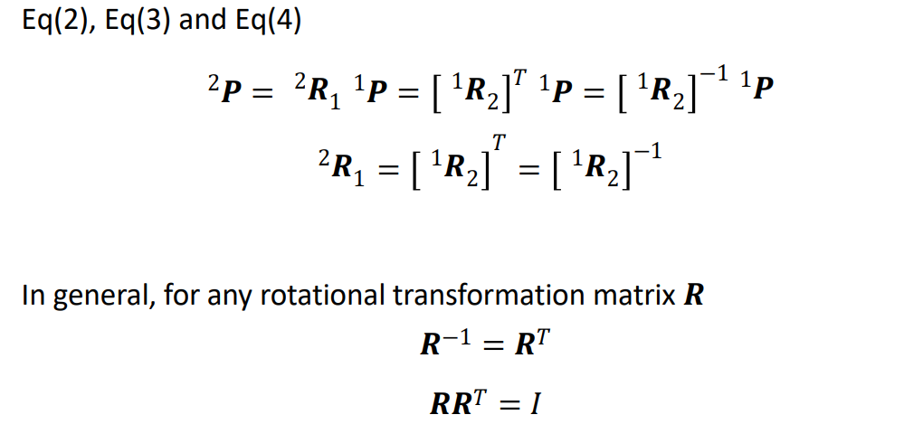

Slide 7
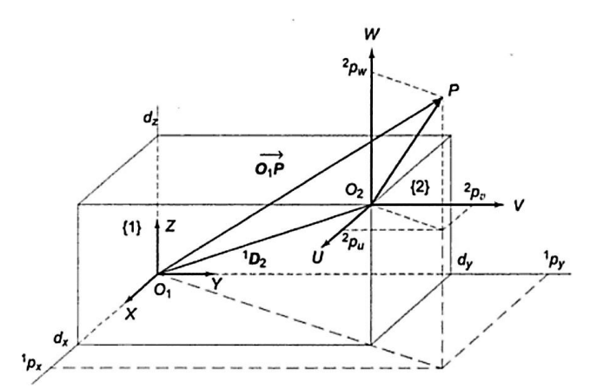


Translated Frame

Slide 8
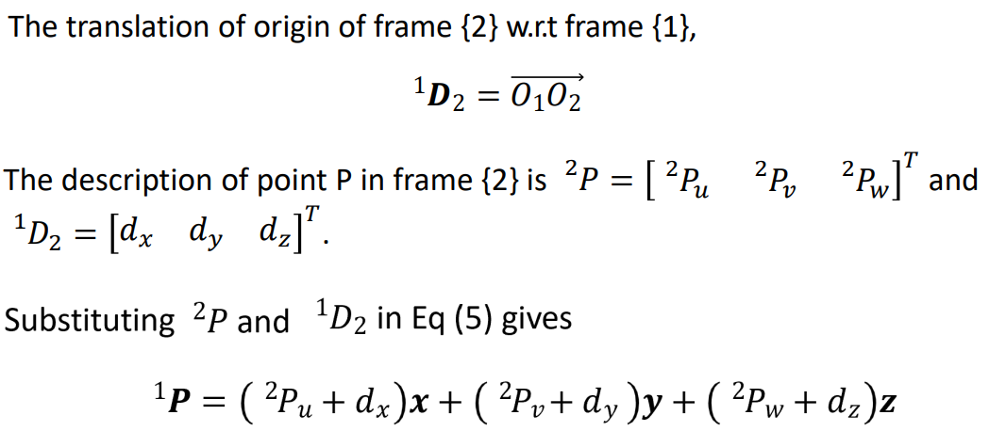

Slide 9














Rotation Matrix
$$z$$
$$z$$
$$,w$$
$$\{1\}$$
$$θ$$
$$v$$
$$\{2\}$$
$$θ$$
$$y$$
$$y$$
$$θ$$
$$x$$
$$x$$
$$u$$

Slide 10
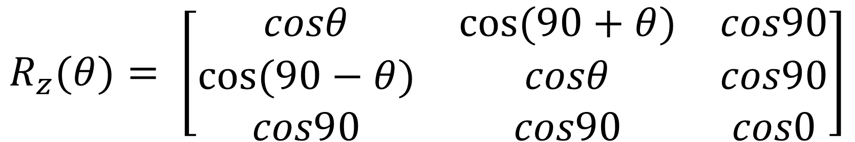
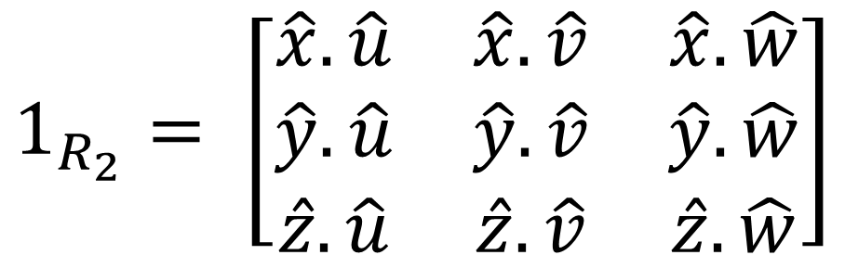
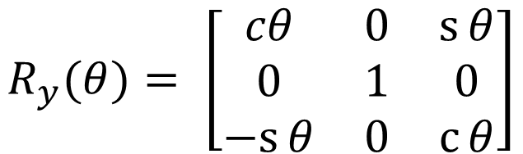
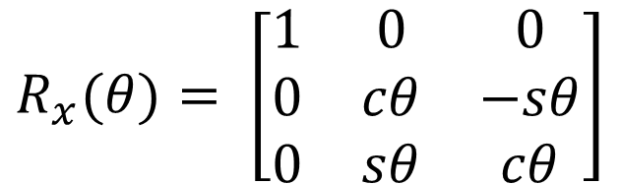
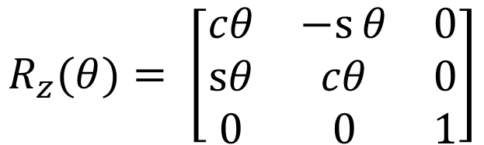
$$1_{R_{2}}= \left[\begin{matrix}\hat{x}.\hat{u} & \hat{x}.\hat{v} & \hat{x}.\hat{w} \\ \hat{y}.\hat{u} & \hat{y}.\hat{v} & \hat{y}.\hat{w} \\ \hat{z}.\hat{u} & \hat{z}.\hat{v} & \hat{z}.\hat{w}\end{matrix}\right]$$
$$R_{z}(θ)= \left[\begin{matrix}cosθ & cos⁡(90+θ) & cos90 \\ cos⁡(90−θ) & cosθ & cos90 \\ cos90 & cos90 & cos0\end{matrix}\right]$$
$$R_{z}(θ)= \left[\begin{matrix}cθ & −s⁡θ & 0 \\ sθ & cθ & 0 \\ 0 & 0 & 1\end{matrix}\right]$$
$$R_{x}(θ)= \left[\begin{matrix}1 & 0 & 0 \\ 0 & cθ & −sθ \\ 0 & sθ & cθ\end{matrix}\right]$$
$$R_{y}(θ)= \left[\begin{matrix}cθ & 0 & s⁡θ \\ 0 & 1 & 0 \\ −s⁡θ & 0 & c⁡θ\end{matrix}\right]$$

Slide 11
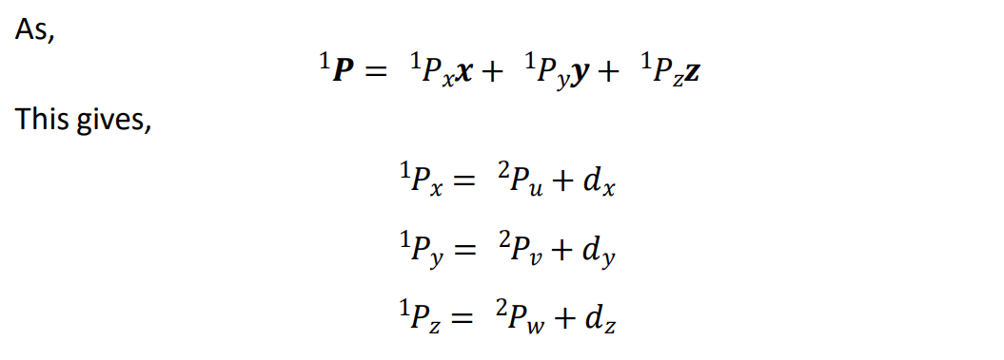
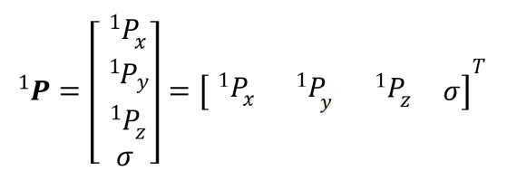


$$Scale Factor$$

Slide 12

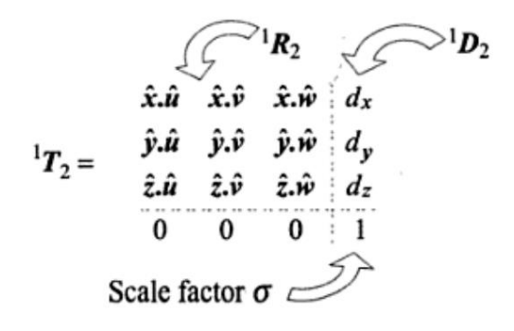
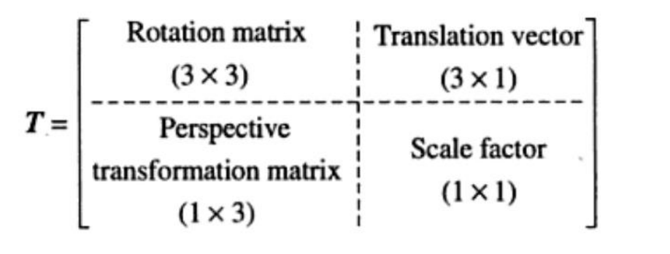

Slide 13
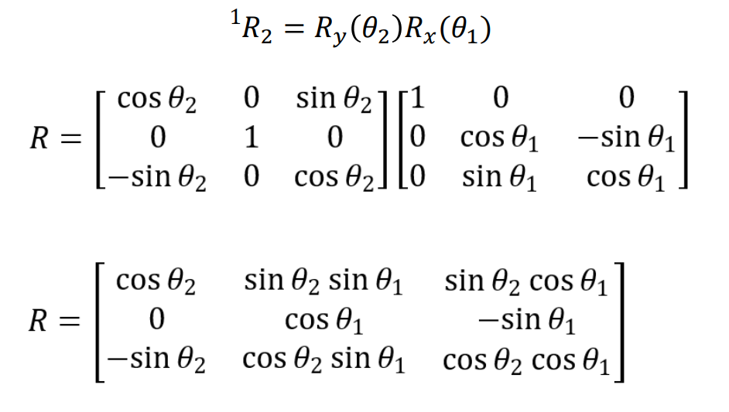
Fundamental Rotation Matrix
The overall rotation matrix representing a rotation of angle 𝜃₁ about x-axis followed by a rotation of angle 𝜃₂ about y-axis is given by,

Slide 14
The sequence of multiplication of 𝑅 matrices is very important.
A different sequence may not give the same result and obviously will not correspond to same orientation of the rotated frame. This is because the matrix product is not commutative.
Two rotations in general do not result in same orientation and the
resultant rotation matrix depends on the order of rotations.

Slide 15
Another significant factor is how the rotations are performed. There are two alternatives.
1. To perform successive rotations about the principal axes of the fixed frame.
2. To perform successive rotations about the current principal axes of a moving frame.

Slide 16
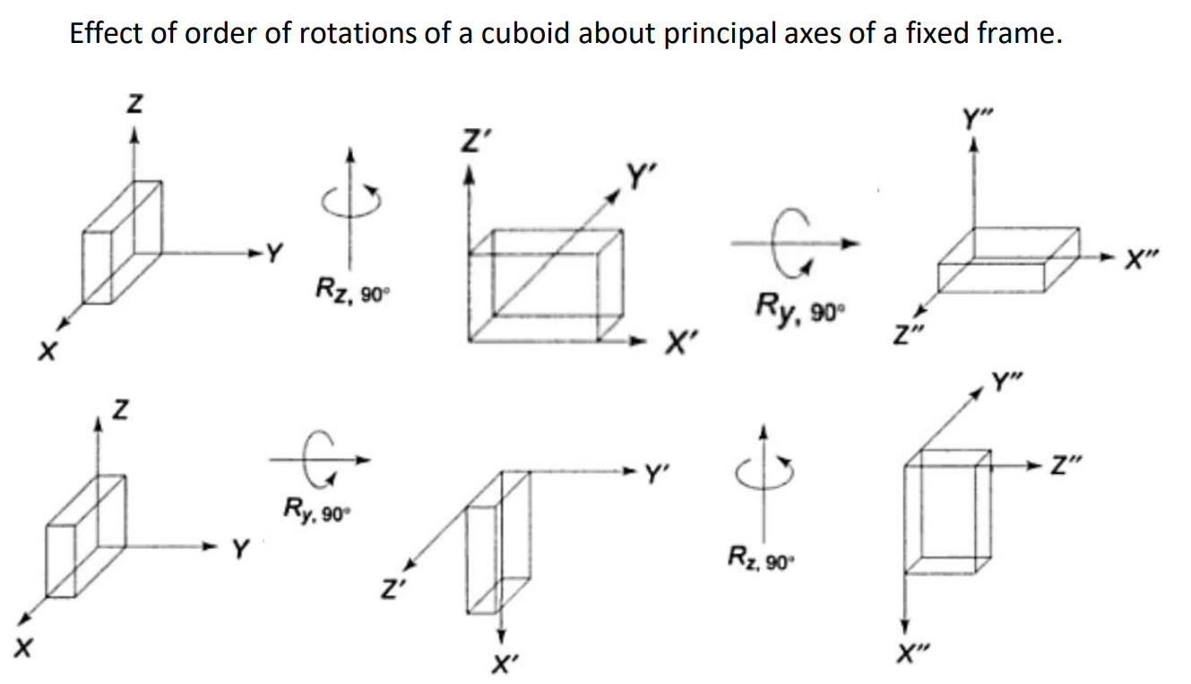

Slide 17
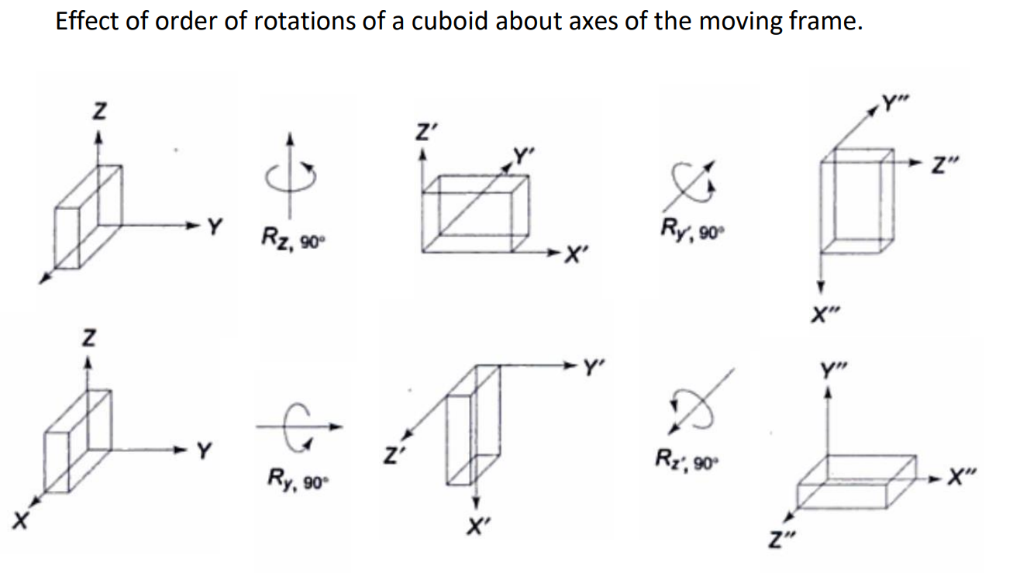

Slide 18
Rigid Body Rotation
Fixed angle representation and Euler Representation

Slide 19
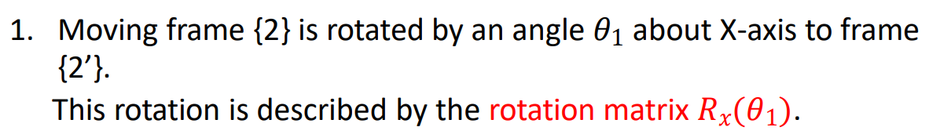
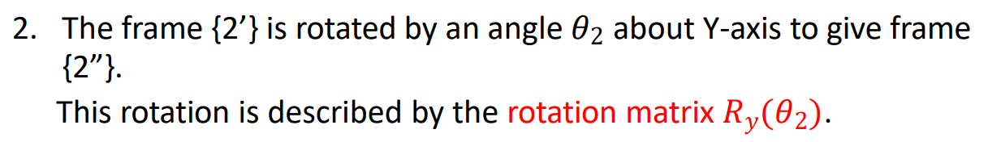
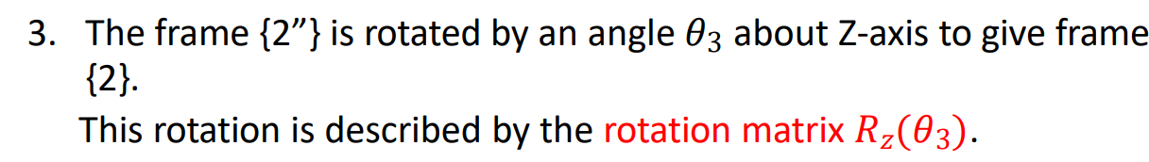
Fixed angle representation
Each rotation is specified about an axis of fixed reference frame.

Slide 20
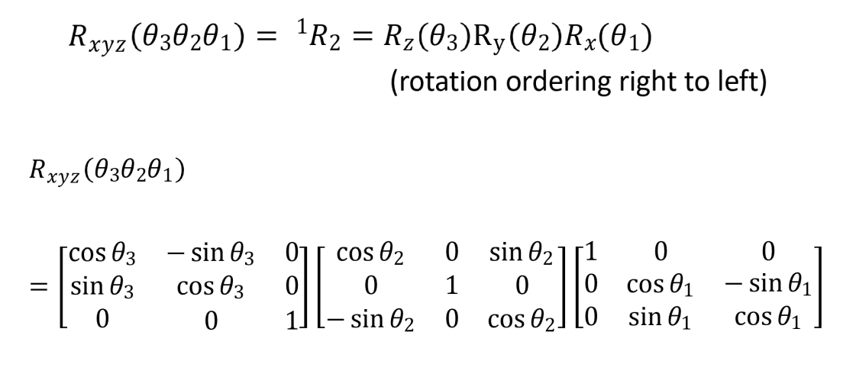

Slide 21
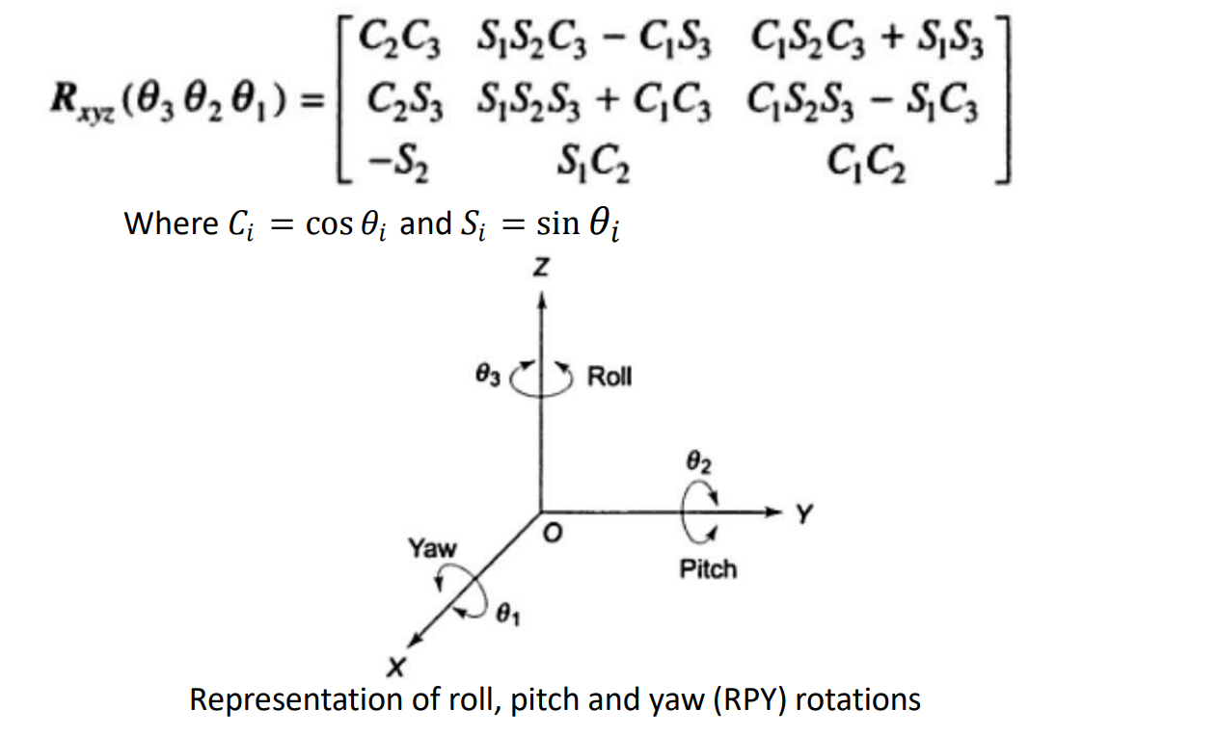

Slide 22
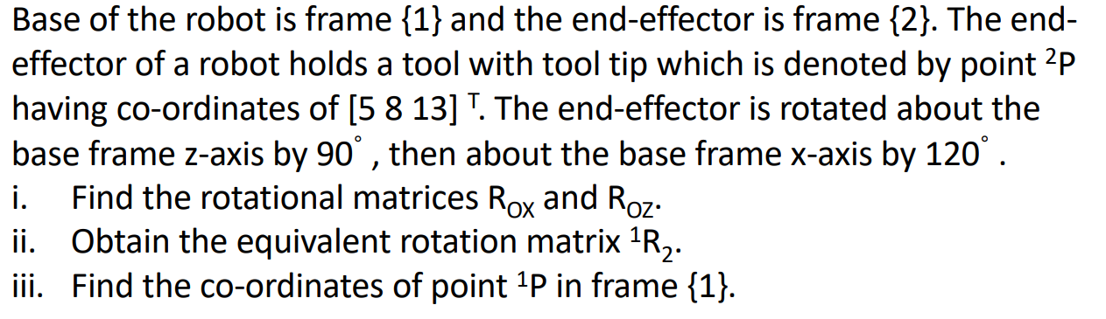
Question

Slide 23
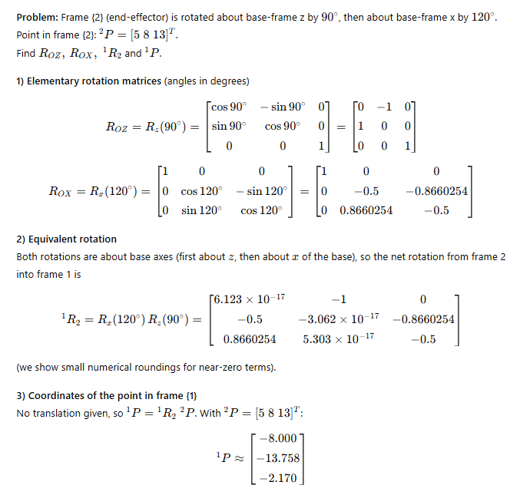

Slide 24
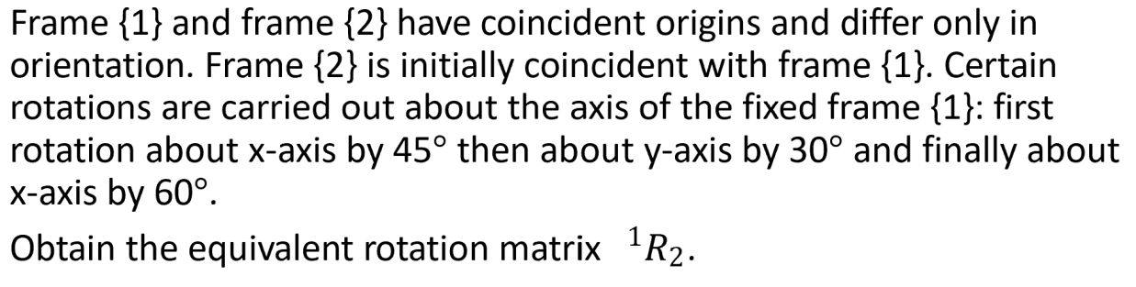
Question

Slide 25
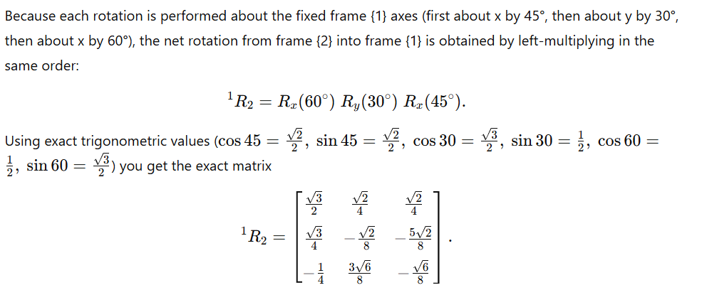

Slide 26
Euler angle representation
The moving frame, instead of rotating about the principal axes of the fixed frame, can rotate about its own principal axes.
Consider the rotations of frame {2} w.r.t frame {1}, starting from the position when the two frames are coincident.
This convention for specifying orientation is called WVU-Euler angle representation.

Slide 27
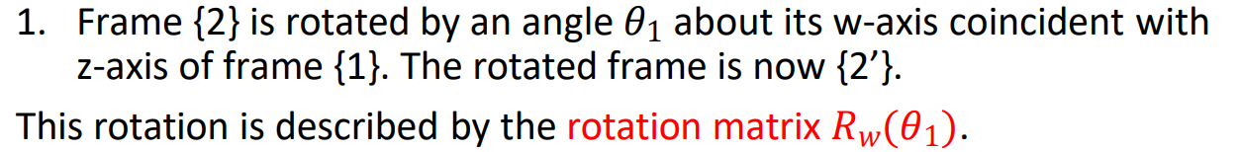
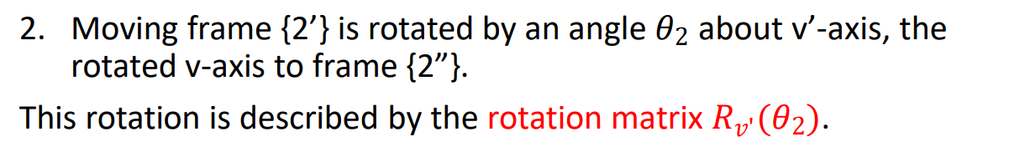
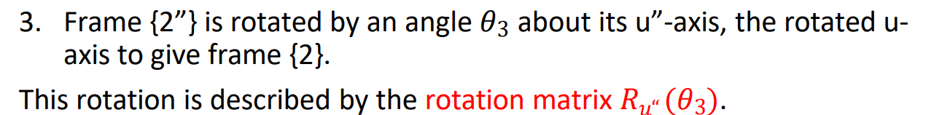

Slide 28
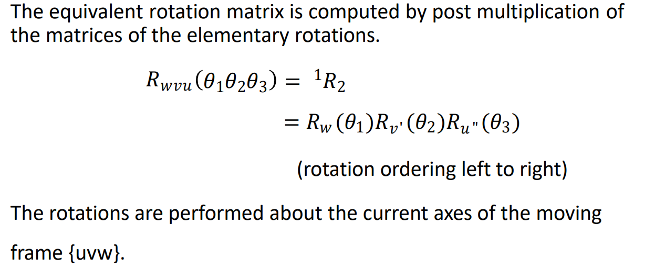

Slide 29
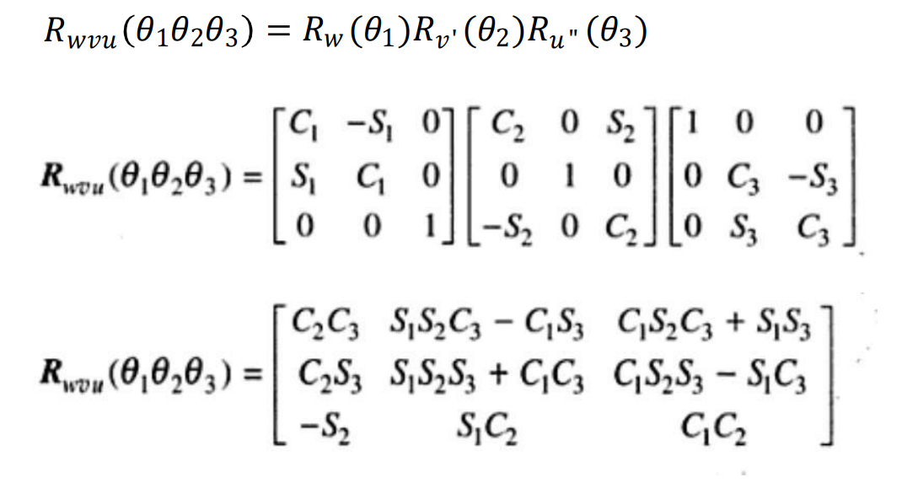

Slide 30
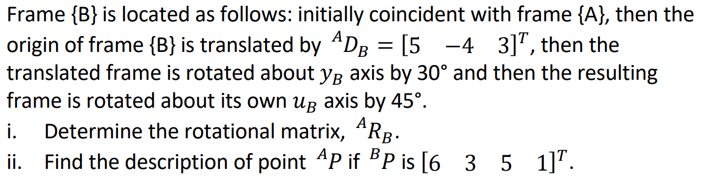
Question

Slide 31
